Slide 1
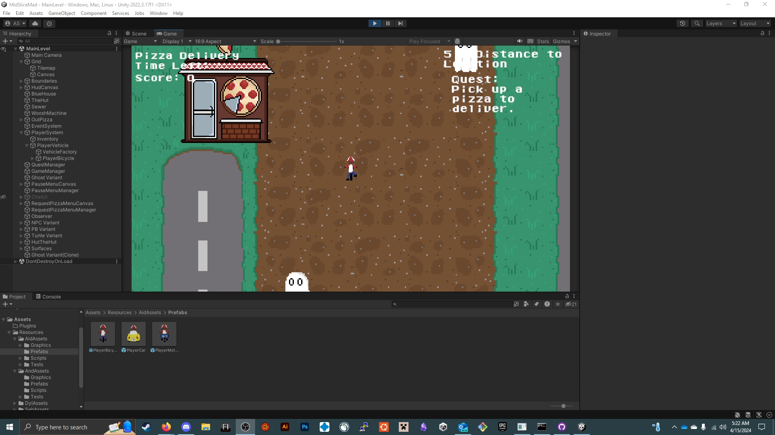
Player Bicycle Prefab
License agreement - Standard Unity Asset Store EULA
License type - Single Entity
File size - 7 KB
Latest release date - 4/15/2024
Original Unity version – 2022.3.17f1
This player bicycle prefab is meant to be used as a playable characters in your game. It is configured by default to move with the keys “wasd” or the arrow keys. Driving around will update the sprite to display a semi 3D animation while also giving the feel of a player of driving around a bicycle with physics.

Slide 2
